Slide 1
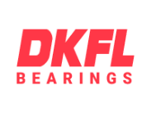
Middle East Kamyar Gostar Producing industrial Co.

Slide 2
Introduction
1
Middle East Kamyar Gostar Producing Industrial Co (from now on Kamyar Gostar) inaugurated in 2015th under management of former Edalati Trading Group company. This new company aims producing high quality Plummer Blocks such as: SN series and Pillow Block Series (UCP, UCF, UCFL, UCT) with new technologies and high quality technology, using DKFL and H&K brands.

Slide 3
DKFL HISTORY
2
1904
This history began in 1904 in Plagwitz, a district of Leipzig, Germany, as Friedrich Wilhelm Witte began to manufacture radial and axial deep groove ball bearings up to a diameter of 150mm under the name of Leipziger Kugellager GmbH.
Up to 1934, the plant increased immensely, so that within two years of construction a second plant was built in Böhlitz-Ehrenberg, a present-day district of Leipzig. Under the brand name DKF (Deutsche Kugellagerfabrik), 1.500 employees produced not only needle and deep groove ball bearings, but also radial and axial bearings, four-point bearings with split outer ring, flange bearings and, during the Second World War, special bearings for aircraft and tank engines.

Slide 4
DKFL HISTORY
3
1945
In 1945 the company was refounded as Leipziger Kugellagerfabrik SAG (Soviet public company). With a revised trademark, namely the three letters DKF and the Leipzig Völkerschlachtdenkmal, which is still part of the KRW logo in a modified form, the existing product range has been expanded to include double row spherical roller bearings in the diameters from 40 to 1.400mm and axial spherical roller bearings.

Slide 5
DKFL HISTORY
4
1955
After 10 years, the SAG was transferred to a state-owned enterprise - VEB Wälzlagerwerk Leipzig was established and employed 1.700 employees until the fall of the Berlin Wall. The brand DKF was retained.
1980
The VEB Wälzlagerwerk Leipzig produced up to 385.000 rolling bearings were each year, which were inquired and used worldwide. Due to these high sales volumes, they enlarged the factory area up to 76.000 sqm.

Slide 6
DKFL HISTORY
5
1990
With the end of the GDR came the end of the VEB Wälzlagerwerk Leipzig. According to the agreement between Treuhandanstalt and FAG Kugelfischer in 1990, the Schweinfurt-based rolling bearing company purchased all eight rolling bearing VEBs of the Kombinat for 27 million DM with a total of 7.500 employees.
In the same year Deutsche Kugellagerfabriken Leipzig GmbH was founded, which later changed its name to DKFL Deutsche Kugellagerfabriken GmbH. Within one year 1.000 workers were dismissed. Already at the end of 1992, FAG Group had to sell DKFL, which was forced to file for bankruptcy. This ended the brand name DKF.

Slide 7
NEW ERA OF DKFL BRAND
6
From the 1970th and first of 1980th decade JAHAN BALLBEARING EDALATI (Mr. Hashem Edalati) was the agent of DKF and later DKFL brand in Iran, later this company faced many problems for payment and also other different problems made this company faced problems for supplying DKFL products.
With the end of DKFL brand in Germany and after nearly 30 years from the time Jahan Ballbearing Edalati was the agent of DKFL Brand, now Kamyar Gostar Company under management of Hashem Edalati son (Kazem Edalati), try to renew this brand in Middle East and because this brand already ended many years ago in Germany Kamyar Gostar decided to use this brand again as high quality brand bearings we import from China.

Slide 8
Kamyar Gostar Vision
7
Producing high quality Plummer Block and Pillow block and adapter sleeves under DKFL brand for high quality and H&K brands for normal quality.
Import of high quality Z3V3 bearings under P6 level from China best bearing factories.
Producing high quality lithium and lithium complex grease in Iran with DKFL Brand.

Slide 9
8
Future Perspective
Make DKFL as one of the best brand bearings, grease, industrial chains, belts and V-Belts in Iran and try to import and produce larger range of bearings and export of goods to middle east countries:
Make wider the range of products produce inside Iran to make more help for making more jobs and make Iran market less dependent on foreign products with same quality as European brand quality.
Focusing on advertising through mass media, and promotional tools across the country.
Automotive Market
Agricultural Market
Industrial Market
Special Use

Slide 10
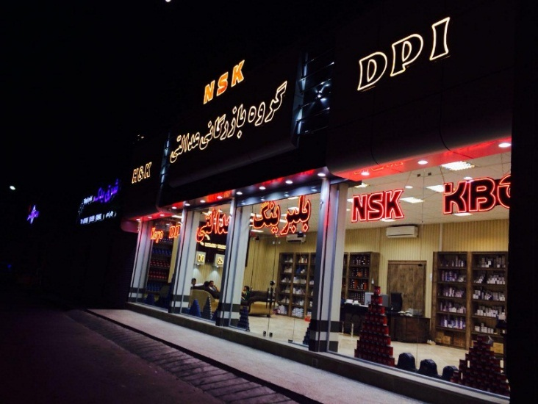
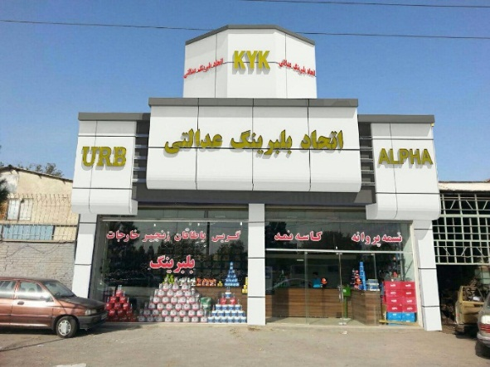
9
Future Perspective
Inauguration of exclusive sales stores for DKFL brand products in Isfahan, Tabriz, Shiraz, and other industrial cities, and expanding sales and developing more stores in Tehran is one of the main goals of Kamyar Gostar Company.

Slide 11
10
Future Perspective cont.
Providing all kinds of bearings used by in different fields and for different purposes (Industrial, Automotive, agricultural, and special use).
Sending an experienced and professional group to different companies for analyzing the quality of bearings, finding errors, and helping the companies to use the best and most suitable kinds of bearings.
Organizing and holding seminars two times yearly for direct meetings with managers, technicians, owners, agents, and retailers.
Sending our best agents and sellers to China with covering all charges to help them see partner factories and update their information.

Slide 12
Ettehad Ball Bearing Co. Ltd Add: After Dizi Sangi- Before Manzel Abad- Sento Rd- Mashhad
11
The duties defined for this office is selling and distributing industrial ball bearings and the most important target is gaining industry market in country.

Slide 13
NSK Store Add: Kooshesh 11- Kooshesh Street- Mashhad
12
Distribution of NSK Brand Ball Bearings, Located in Mashhad

Slide 14
NSK Store Cont.
13

Slide 15
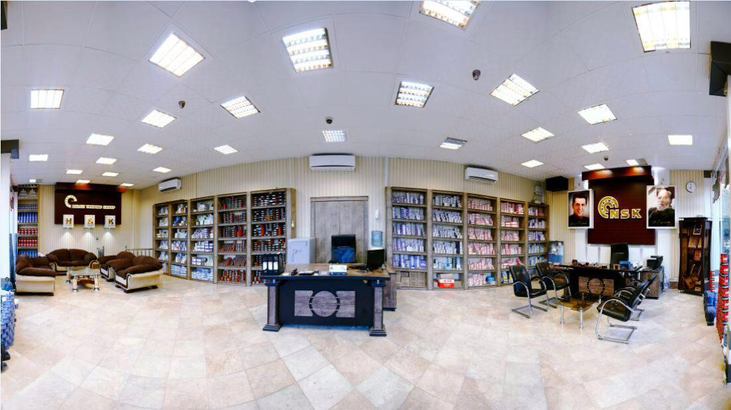
NSK Store Cont.
14

Slide 16
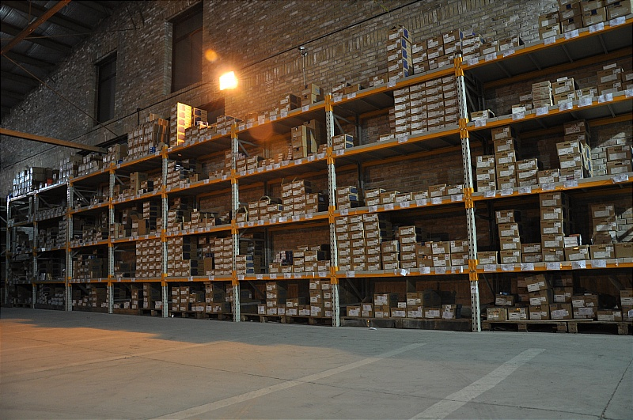
Warehouse Photos
15

Slide 17
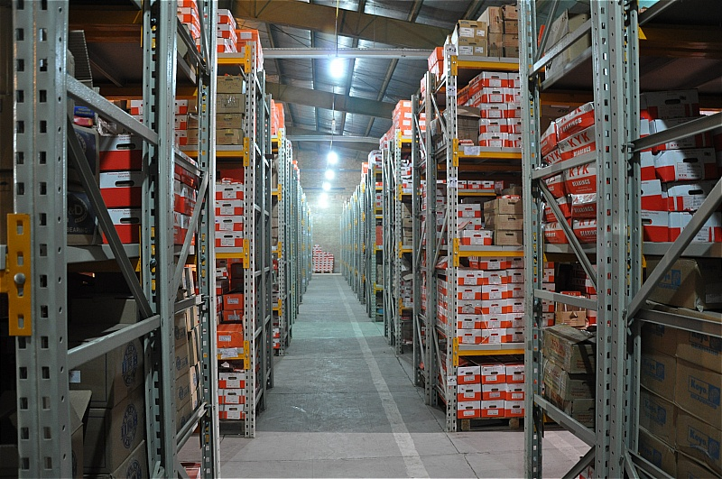
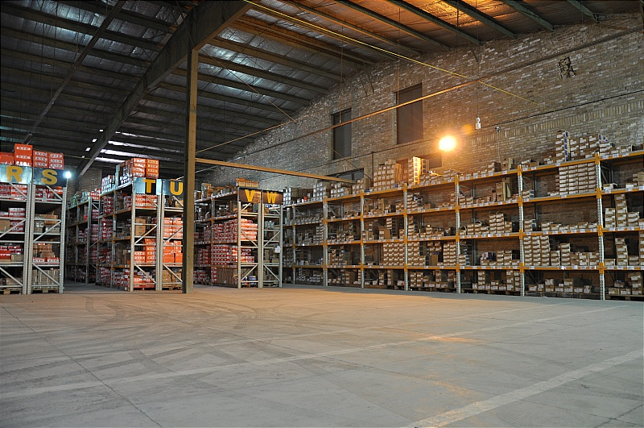
Warehouse Photos
16

Slide 18
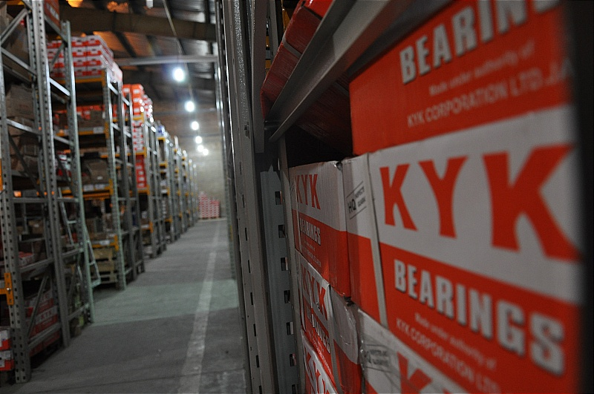
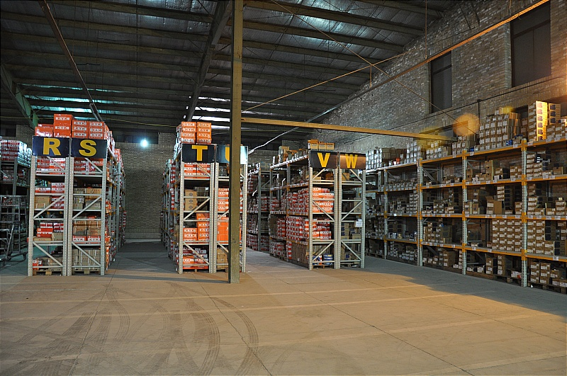
Warehouse Photos
17

Slide 19
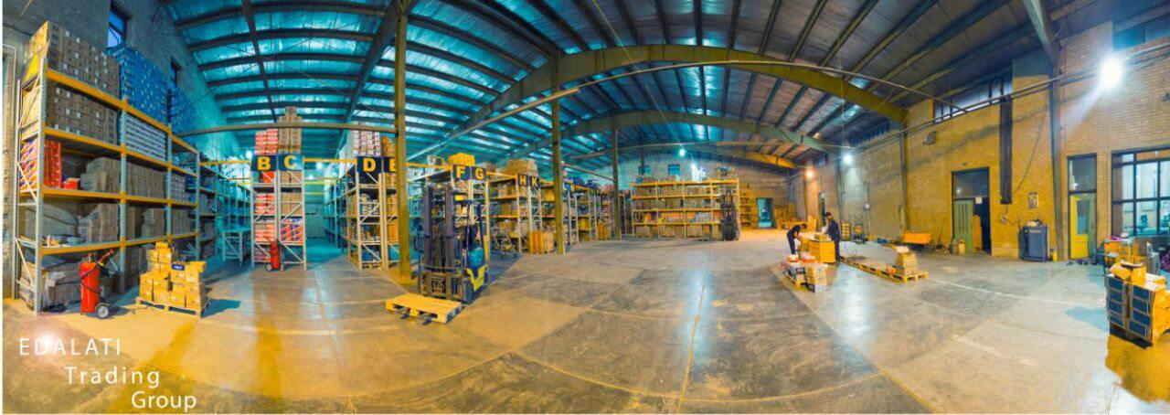
Warehouse Photos
18

Slide 20
Thanks for your attention
end

